Slide 1

Colorectal Cancer Screening Update:
Blood-based Testing for Cancer
Robert E. Schoen, MD, MPH
Professor of Medicine & Epidemiology
University of Pittsburgh │ UPMC Pittsburgh, PA

Slide 2
Disclosures
Research Support:
Freenome
Immunovia, Inc.
Exact Sciences

Slide 3
ctDNA: Circulating Tumor DNA
As cancer cells turn over, release their DNA into adjacent media
ctDNA means detecting mutant DNA – DNA with somatic mutations within driver genes that are responsible for clonal growth
Epigenetic changes (methylation), DNA fragmentomics, and proteins are also potential targets to detect tumors in blood

Slide 4
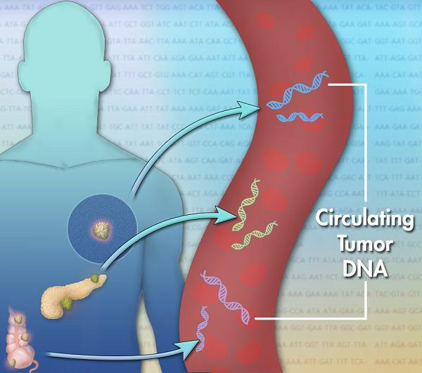

Slide 5
cf (cell free) DNA vs.
ct (circulating tumor) DNA
Vast majority of cfDNA is from hematopoietic cells.
ctDNA is from lysed tumor cells
ctDNA is mostly short fragments (166bp)
Apoptotic release primary cause
Don’t fully understand etiology of either presence or the level – not directly proportional to tumor size/stage

Slide 6
Challenges
Sensitivity: Can be <1 mutant molecule/ml of plasma: requires large volume plasma for testing
Specificity: Are other sources of mutant DNA – CHIP – clonal hematopoiesis of indeterminate potential
Because mutations not specific to one type of cancer: how do you identify tissue of origin?

Slide 7





MCED: Multi Cancer Early Detection
Ken
Kinzler
Bert
Vogelstein
Nick
Papadopoulos

Slide 8
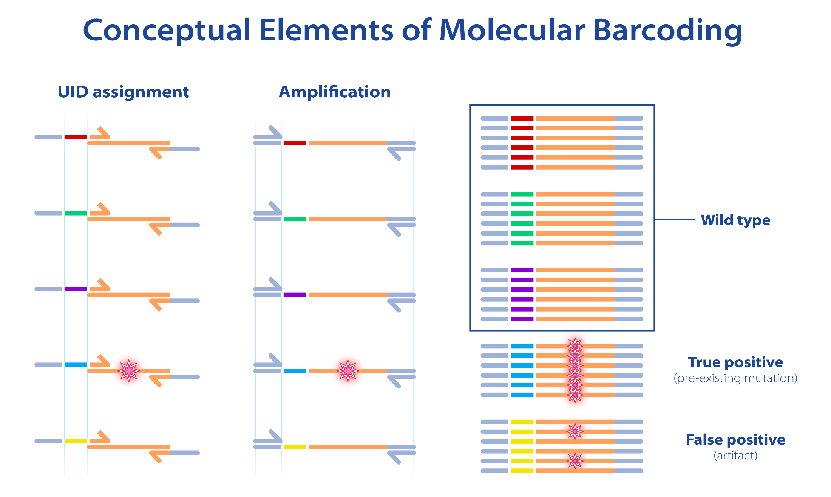
Digital Genomics: SafeSeqs
UID – Unique IDentifier
Cohen J. Can Epi Biomarker 2020

Slide 9
CancerSEEK Study
1,005 Cancer Patients
  209 Breast
  288 Colorectal
  45 Esophageal
  44 Liver
  104 Lung
  54 Ovarian
  93 Pancreatic
  68 Stomach
812 Healthy Controls
No Distant Metastases
  20% Stage I
  49% Stage II
  31% Stage III
Median Age 64 years
Cohen J, et al. Science 2018
Notes:
Selected 41 markers that were elevated in > 10% of at least one of the 8 cancer types with > 99% specfiicty. 39 could be reproducibly assayed in a multiplexed assay with Luminex Bead based assays on a Bioprad Bioplex 200 instrument.

Slide 10
Protein Markers
ctDNA not sensitive enough proteins
Use high cut offs to insure maximum specificity
8 proteins useful

Slide 11
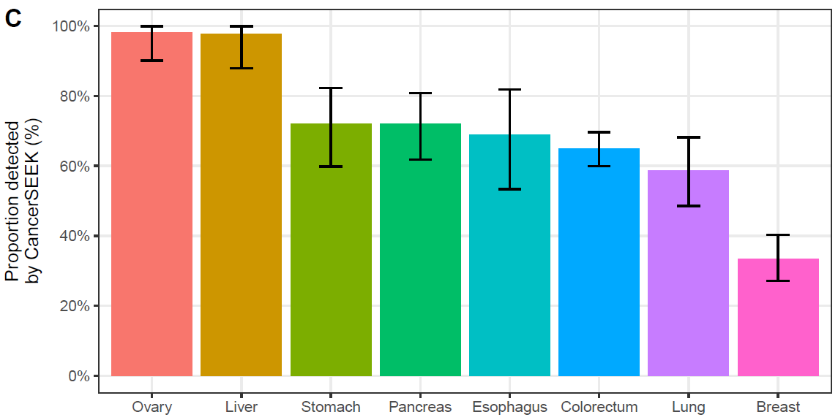
CancerSEEK Sensitivity
69% to 98%
70% Median Sensitivity (p < 10⁻⁹⁶ one-sided binominal)
>99% Specificity (7 of 812 Healthy Controls)
Range (33% to 98%)
Ovary
Liver
Stomach
Pancreas
Esoph
Colon
Lung
Breast
Notes:
62% average
55% when adjusted for tumor distributions in populations.

Slide 12
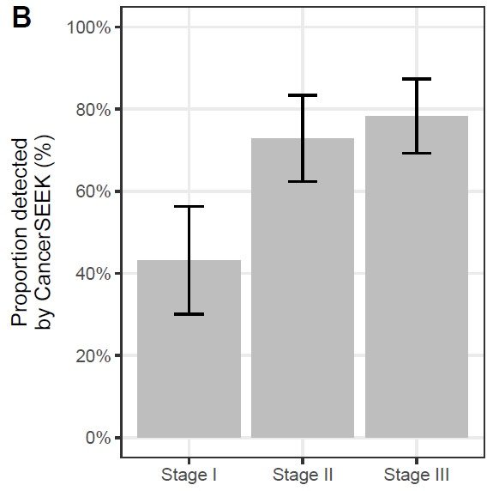
Colorectal Cancer CancerSEEK
Sensitivity by Stage
78%
73%
43%
Cohen, et al. Science 2018
Notes:
Stage 1 ranged from 20% for Eso to 100% for Liver
No independent test group
Most patients presented with symptoms
Need a prospective trial

Slide 13
Tissue Confirmation
N=153
Mutation in plasma identical to mutation in tumor in 138/153 (90%)
Concordance between plasma and tumor: present in all tumor types – ranging from 100% in ovarian/pancreas to 82% in stomach

Slide 14
Positive Test:
What is Cancer Site of Origin?
Machine learning in 626 patients with positive test
Uses ctDNA mutation, protein biomarker, gender

Slide 15
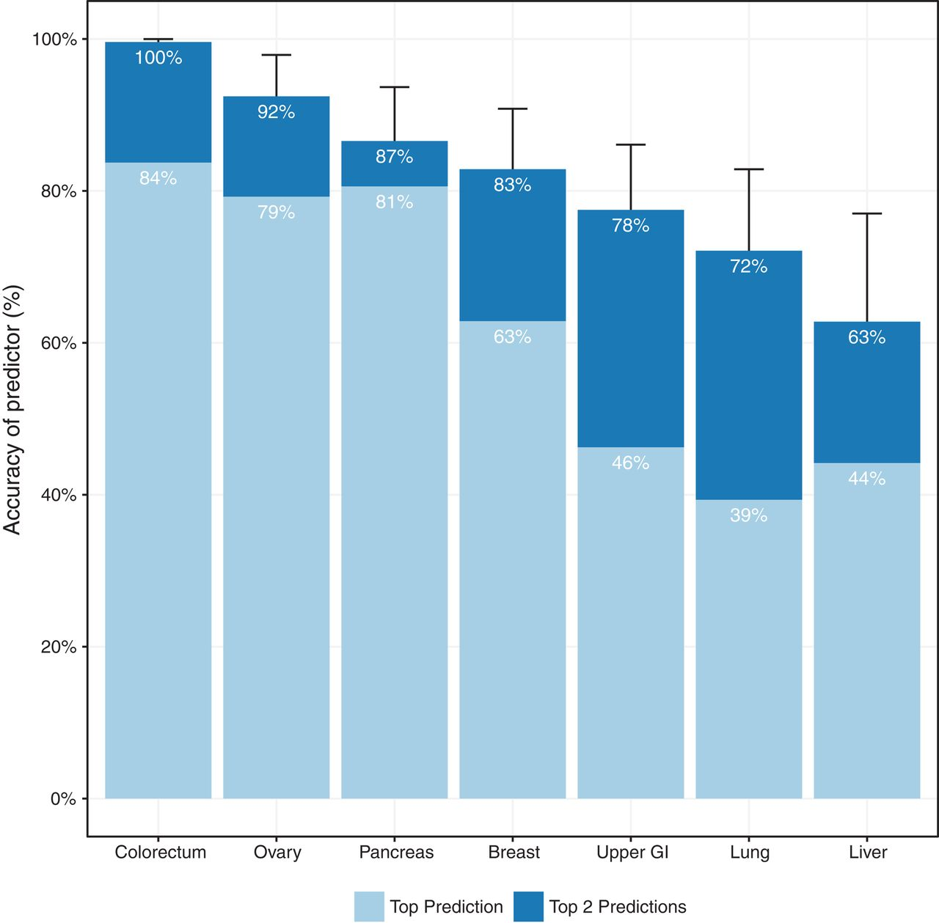
Top Prediction was correct in a median of 63% of the cases.
(p < 10⁻⁴⁷ one-sided binomial test)
Top 2 Prediction identified the site in a median of 83% of the cases.
(p < 10⁻⁷⁷ one-sided binomial test)

Slide 16

Raised $1.9 Billion
Illumina reaquired:
$8 Billion – FTC court battle

Slide 17
Grail: Multi-Cancer Detection Using
Targeted Methylation Signatures in cfDNA
Cell-free Genome Atlas Study (CCGA):
N= >2400 Cancers, >4K controls - 50 cancer types
Training/validation: Set specificity at 99.3%
Sensitivity 67% (95%CI 61-73%) for stage I-III in 12 “high signal”; 44% overall sensitivity cancer
TOO localization accurate in 93%
Liu, Ann Oncology 2020

Slide 18
83%
69%
39%
93%
Liu; Ann Oncology 2020

Slide 19
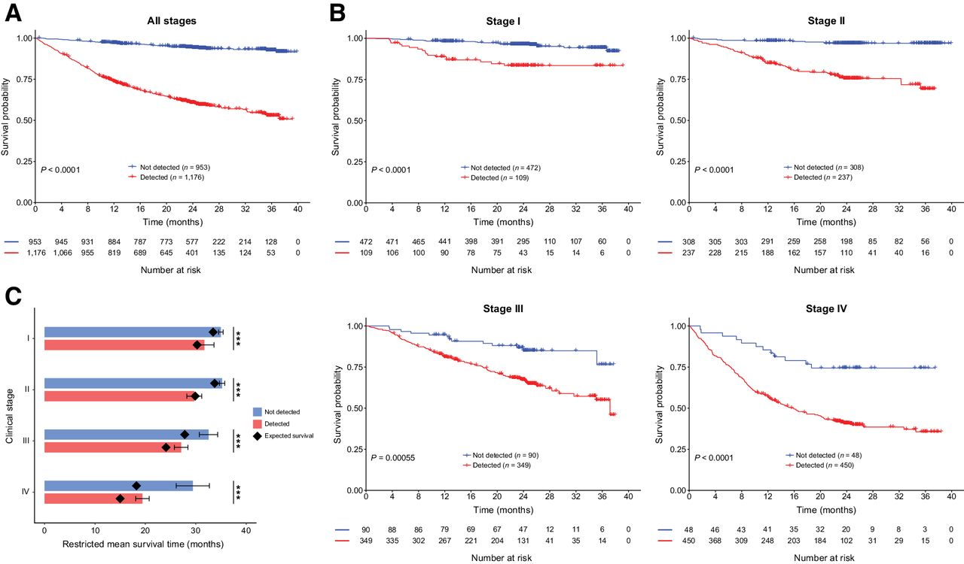
MCED Not-Detected Cancers Have Better Survival than Detected
Chen; Clin CA Resch 2021

Slide 20
MCED Not-Detected Cancers have Better Survival Within Stage

Slide 21
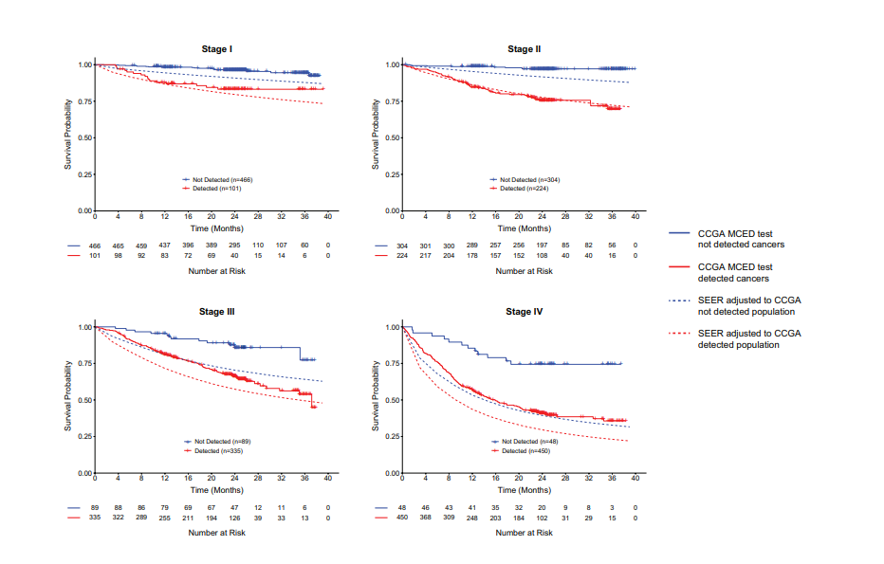
MCED Not-Detected Cancers Have Better Survival Compared to SEER
Compare Solid to Dotted (SEER) line

Slide 22
MCED Detection
Detected cancers worse prognosis
Not-Detected less aggressive
MCED less likely to add to “overdiagnosis”?

Slide 23

$950.00 – not covered by insurance
Result: “Cancer Signal”: Detected or Not

Slide 24
Market Forces and MCED Testing
MCED market estimated at $50B by 2035

Slide 25

Multi-Cancer Early Detection:
DETECT-A Trial
Detecting cancers Earlier Through Elective mutation-based blood Collection and Testing
Anne Marie Lennon et al. Science 2020

Slide 26
DETECT-A Study
10K women, age 65-75 in Geisinger Health System
2 consecutive positive test results will warrant evaluation
Subjects will be followed for clinical signs of cancer for at least 2 years

Slide 27
9911 ♀ Baseline Test
(16 genes + 9 proteins)
490 positive (4.9%)
214 CHIP
142 NOT identical
134 positive again (1.4%)
127 PET-CT
26 Cancers
TP
101 No Cancer
FP
24 Cancers detected by SOC
46 Cancers detected by neither
26/96 = 27%
Notes:
Review PLCO Flow diagram

Slide 28
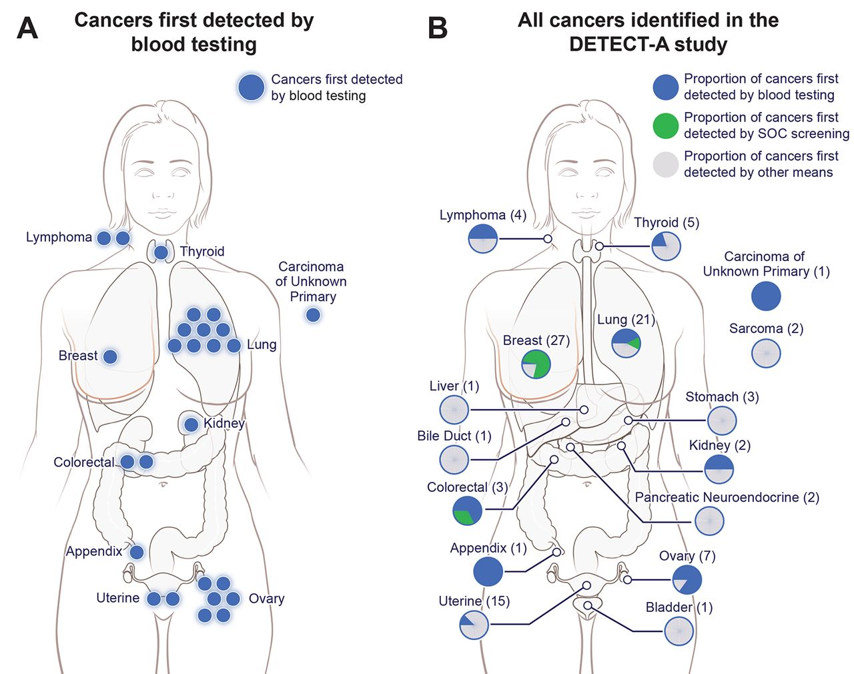
Notes:
Overview of cancers incident during the DETECT-A study. (A) Twenty-six cancers (blue) in 10 organs were first detected by blood testing. (B) Ninety-six cancers were identified in the study (see Supplementary Materials). The location, and number of those first detected by blood testing (blue), standard-of-care screening (green) or by other means (grey) are shown.

Slide 29
Stage of Cancers Detected by Blood Screening
Stage
#
I 5
II 3
III 8
IV 9
Pending 1

Slide 30
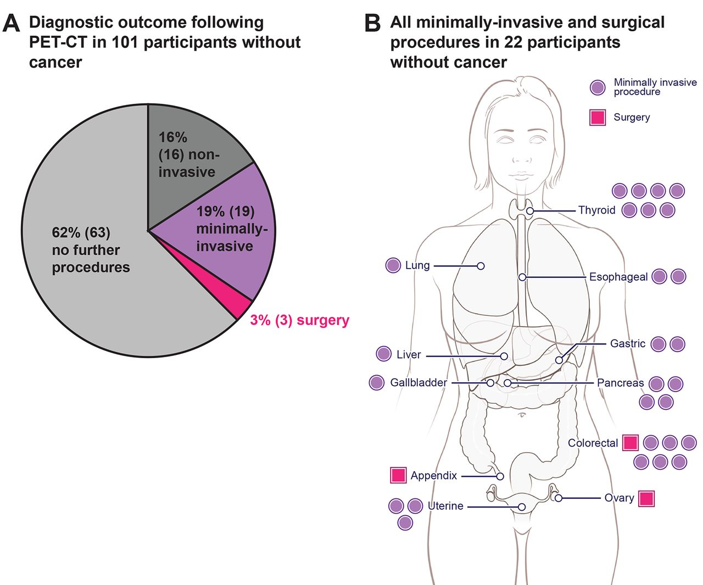
The False Positive Burden in #101 Without Cancer
Non-invasive: Xray, CT, USG
Min invasive: EGD, hysteroscopy
Surgery: HGD in colon, mucinous cystadenoma ovary, in situ CA appendix
Notes:
Risk exposure in participants without cancer but with positive DETECT-A blood tests. (A) 101 participants with positive DETECT-A blood tests underwent a diagnostic PET-CT but had no cancer identified. Risk stratifications are defined in table S12. Only the most invasive procedure a participant underwent is shown; for example, a participant who received minimally-invasive follow-up (e.g., a bronchoscopy) may also have first received non-invasive follow-up (e.g., a follow-up chest CT) (table S10). (B) Anatomical locations of minimally-invasive or surgical procedures following diagnostic PET-CT in the 22 participants with positive PET-CT imaging but without cancer. Each dot or square indicates a single procedure; seven participants had more than one minimally-invasive or surgical procedure, which explains why there are 30 procedures depicted in the 22 patients.

Slide 31
DETECT-A Issues
PPV is dependent on specificity and prevalence of disease in population. Even with high specificity (>99%), the low prevalence of cancer means that most positive multi-cancer blood tests will be FALSE POSITIVES
Didn’t interfere with standard of care screening
Sensitivity – didn’t detect 46/96 (48%) cancers

Slide 32
Multi-Cancer vs Single Cancer
Search for more cancers means higher population prevalence, leads to higher PPV
Some cancers – ctDNA is sensitive: liver, ovary; others such as breast CA – low sensitivity
Limited sensitivity for early stage cancers remains a concern

Slide 33
CRC Blood Based Screening –
“Registration” Trials
Freenome (800M)– “Preempt” (N=26K) – Multiomic Platform
Guardant (Market Cap 8B): “Eclipse” trial - Lunar2 Assay – genomic, methylation and fragmentomics: (N=10K)

Slide 34
CRC Screening Effectiveness
• Early Detection
• Prevention Through Removal of
Precursor Lesions
Estimated that about 2/3rd of the reduction
in CRC mortality in PLCO trial is attributable
to the reduction in incidence
Douroudi M. Cancer 2017:123:4815

Slide 35
Considerations in Developing
a Blood test for CRC
Colon: Specificity not as much of concern – current practice is to colonoscope everyone – so, false positives that lead to extra CS exams not much of a concern
Colon: Detecting advanced adenoma is critical to prevention aim – success in detected cancer is not sufficient

Slide 36
What I Will Be Looking For
CMS has issued guidance for reimbursement of blood test for cancer: 74% sensitivity for cancer (FIT) at 90% specificity (Cologuard)
Expect tests will achieve sensitivity thresholds for cancer – 90+%
Interested in detection of early stage cancers – though there will be few to study
Interested in detection of advanced adenoma

Slide 37
Blood-based Biomarkers
Offer less invasive, less burdensome screening alternative
Could potentially screen the unscreened and reduce disparities
Potential for multi-cancer detection
Role in monitoring for cancer recurrence
Can impact early detection, management, and outcome

Slide 38
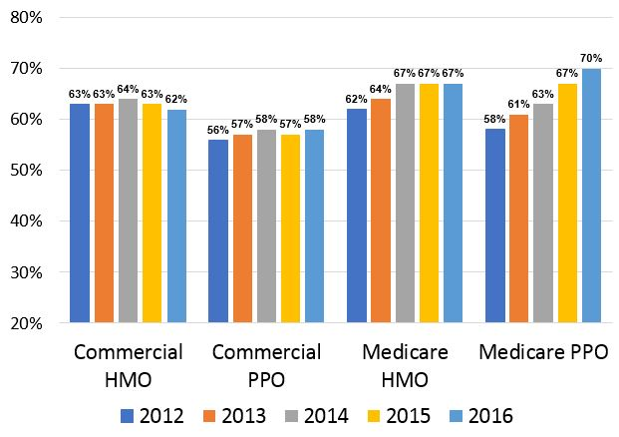
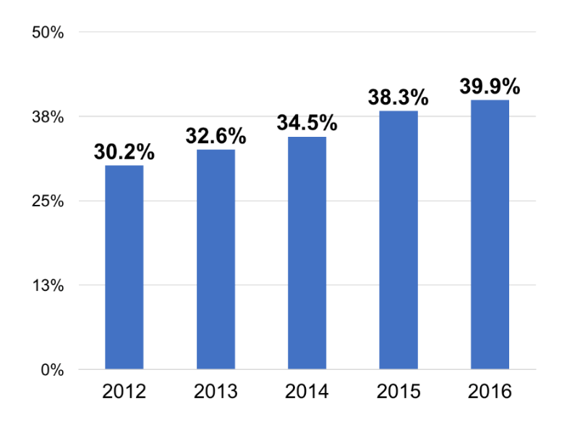
National Screening Rates: Disparities
Community Health Centers
Insured Adults - HEDIS

